Slide 1
CPUs
Caches.
Memory management.

Slide 2
Caches and CPUs
address
data
cache
main
memory
CPU
cache
controller
address
data
data

Slide 3
Cache operation
Many main memory locations are mapped onto one cache entry.
May have caches for:
  instructions;
  data;
  data + instructions (unified).
Memory access time is no longer deterministic.

Slide 4
Terms
Cache hit: required location is in cache.
Cache miss: required location is not in cache.
Working set: set of locations used by program in a time interval.

Slide 5
Types of misses
Compulsory (cold): location has never been accessed.
Capacity: working set is too large.
Conflict: multiple locations in working set map to same cache entry.

Slide 6
Memory system performance
h = cache hit rate.
t_{cache} = cache access time, t_{main} = main memory access time.
Average memory access time:
  t_{av} = ht_{cache} + (1-h)t_{main}

Slide 7
Multiple levels of cache
L2 cache
CPU
L1 cache

Slide 8
Multi-level cache access time
h₁ = cache hit rate.
h₂ = rate for miss on L1, hit on L2.
Average memory access time:
  t_{av} = h₁t_{L1} + (h₂-h₁)t_{L2 +} (1- h₂-h₁)t_{main}

Slide 9
Replacement policies
Replacement policy: strategy for choosing which cache entry to throw out to make room for a new memory location.
Two popular strategies:
  Random.
  Least-recently used (LRU).

Slide 10
Cache organizations
Fully-associative: any memory location can be stored anywhere in the cache (almost never implemented).
Direct-mapped: each memory location maps onto exactly one cache entry.
N-way set-associative: each memory location can go into one of n sets.

Slide 11
Cache performance benefits
Keep frequently-accessed locations in fast cache.
Cache retrieves more than one word at a time.
  Sequential accesses are faster after first access.

Slide 12
Direct-mapped cache
valid
tag
data
1
0xabcd
byte byte byte ...
cache block
tag
index
offset
=
hit
value
byte

Slide 13
Write operations
Write-through: immediately copy write to main memory.
Write-back: write to main memory only when location is removed from cache.

Slide 14
Direct-mapped cache locations
Many locations map onto the same cache block.
Conflict misses are easy to generate:
  Array a[] uses locations 0, 1, 2, …
  Array b[] uses locations 1024, 1025, 1026, …
  Operation a[i] + b[i] generates conflict misses.

Slide 15
Set-associative cache
A set of direct-mapped caches:
Set 1
Set 2
Set n
...
hit
data

Slide 16
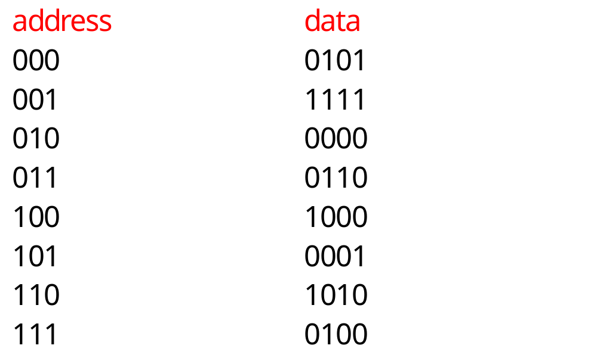
Example: direct-mapped vs. set-associative

Slide 17
Direct-mapped cache behavior
After 001 access:
  block tag data
  00 - -
  01 0 1111
  10 - -
  11 - -
After 010 access:
  block tag data
  00 - -
  01 0 1111
  10 0 0000
  11 - -

Slide 18
Direct-mapped cache behavior, cont’d.
After 011 access:
  block tag data
  00 - -
  01 0 1111
  10 0 0000
  11 0 0110
After 100 access:
  block tag data
  00 1 1000
  01 0 1111
  10 0 0000
  11 0 0110

Slide 19
Direct-mapped cache behavior, cont’d.
After 101 access:
  block tag data
  00 1 1000
  01 1 0001
  10 0 0000
  11 0 0110
After 111 access:
  block tag data
  00 1 1000
  01 1 0001
  10 0 0000
  11 1 0100

Slide 20
2-way set-associtive cache behavior
Final state of cache (twice as big as direct-mapped):
  set blk 0 tag blk 0 data blk 1 tag blk 1 data
  00 1 1000 - -
  01 0 1111 1 0001
  10 0 0000 - -
  11 0 0110 1 0100

Slide 21
2-way set-associative cache behavior
Final state of cache (same size as direct-mapped):
  set blk 0 tag blk 0 data blk 1 tag blk 1 data
  0 01 0000 10 1000
  1 10 0111 11 0100

Slide 22
Example caches
StrongARM:
  16 Kbyte, 32-way, 32-byte block instruction cache.
  16 Kbyte, 32-way, 32-byte block data cache (write-back).
SHARC:
  32-instruction, 2-way instruction cache.

Slide 23
Memory management units
Memory management unit (MMU) translates addresses:
main
memory
CPU
logical
address
memory
management
unit
physical
address

Slide 24
Memory management tasks
Allows programs to move in physical memory during execution.
Allows virtual memory:
  memory images kept in secondary storage;
  images returned to main memory on demand during execution.
Page fault: request for location not resident in memory.

Slide 25
Address translation
Requires some sort of register/table to allow arbitrary mappings of logical to physical addresses.
Two basic schemes:
  segmented;
  paged.
Segmentation and paging can be combined (x86).

Slide 26
Segments and pages
memory
segment 1
page 1
page 2
segment 2

Slide 27
Segment address translation
segment base address
logical address
+
segment lower bound
range
check
range
error
segment upper bound
physical address

Slide 28
Page address translation
page
offset
page i base
concatenate
page
offset

Slide 29
Page table organizations
page
descriptor
page descriptor
flat
tree

Slide 30
Caching address translations
Large translation tables require main memory access.
TLB: cache for address translation.
  Typically small.

Slide 31
ARM memory management
Memory region types:
  section: 1 Mbyte block;
  large page: 64 kbytes;
  small page: 4 kbytes.
An address is marked as section-mapped or page-mapped.
Two-level translation scheme.

Slide 32
ARM address translation
Translation table
base register
1st index
2nd index
offset
1st level table
descriptor
concatenate
concatenate
2nd level table
descriptor
physical address

